Slide 1
Rubik's cube face color extractor
Maris Radu-Ioan
Prof. coordonator Robert Varga

Slide 2
Description
In this project I implemented a live color detector in which I use the camera from my laptop to get live footage and than find the color of each square form the Rubik cube faces.
A black grid is displayed on top of the video footage to indicate to the user where the cube should be positioned.
Even if the cube is not fully in in the center or slightly rotated and out of bounds, the algorithm should detect the color and display it, but not as accurate.
This project is adapted to my laptop camera and in testing it on different one might result in slightly different results due to different color reproduction.

Slide 3
Approach
Take each frame of the video and apply the following transformations:
Convert from BGR (Blue, Green, Red) to HSV (Hue, Saturation, Value).
Create masks for each color of the cube using a color range.
Create a temporary frame which is only the final solid colors of the image.
Press a key to check which color is predominant in each cell (each one of the 9 sections delimited by the borders) and display it in a separate image.
Create the final visualization for each face of the cube.

Slide 4
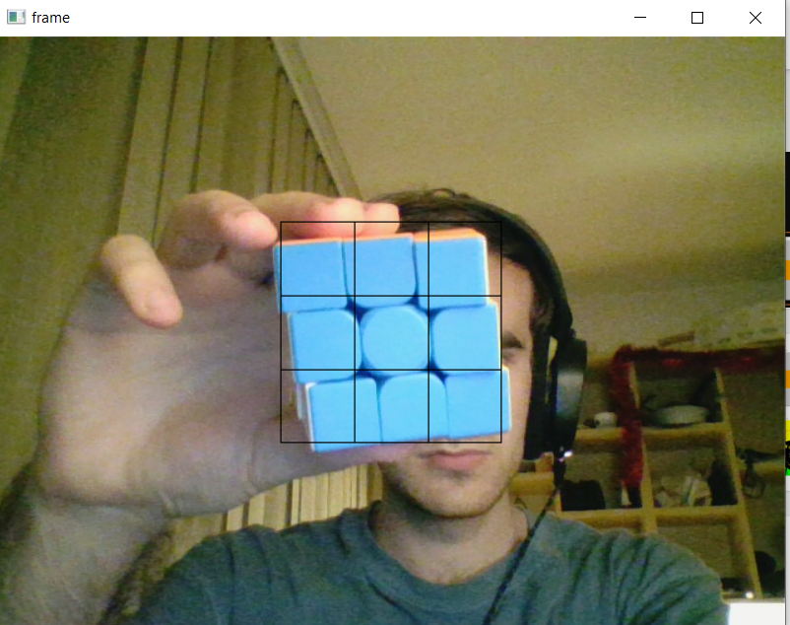
User Guide
In order to use the application, you need to take the cube and rotate it such that it is parallel with the camera. Now, taking one face at the time, try to place the cube at a distance in front of the camera such that each smaller square out of the 9 colored is in the right position inside the borders.
When the cube is correctly aligned, press one of the following buttons (next slide) depending on what color the center piece is and than rotate to the next face.
Example: fig.1

Slide 5
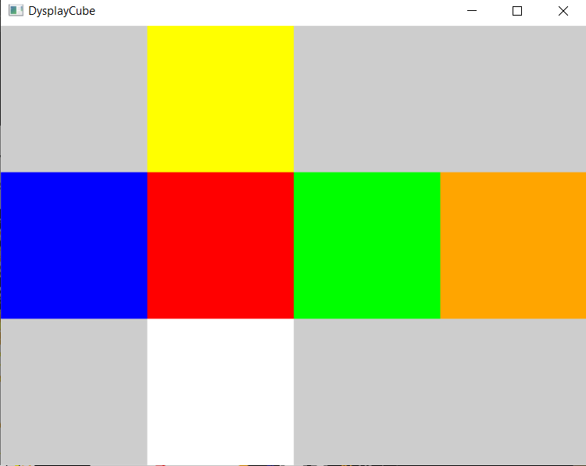
User Guide pt2
A – White
S – Red
D – Blue
S – Orange
A – Green
S – Yellow
This will result in a 2D representation of the 3D cube. This is known as a spread visualization of the cube.

Slide 6
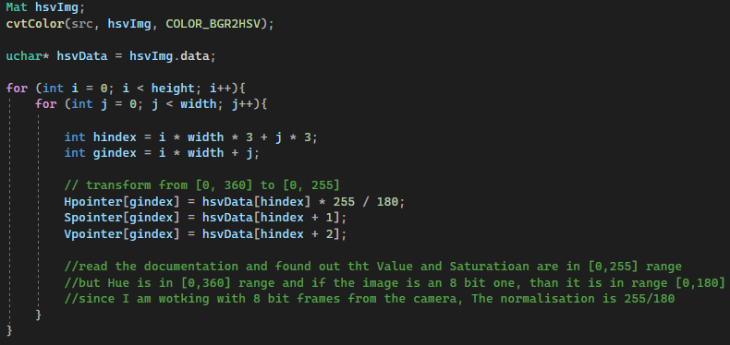

HSV color space
In order to convert from BGR to HSV I used the function COLOR_BGR2HSV from OpenCV and performed normalizations. Saturation and Value did not need it because the function translates them in [0,255] range, but the Hue is in [0,180] range for 8 bit images.
Formula for normalisation
a = 0 b=180
c = 0 d=255

Slide 7
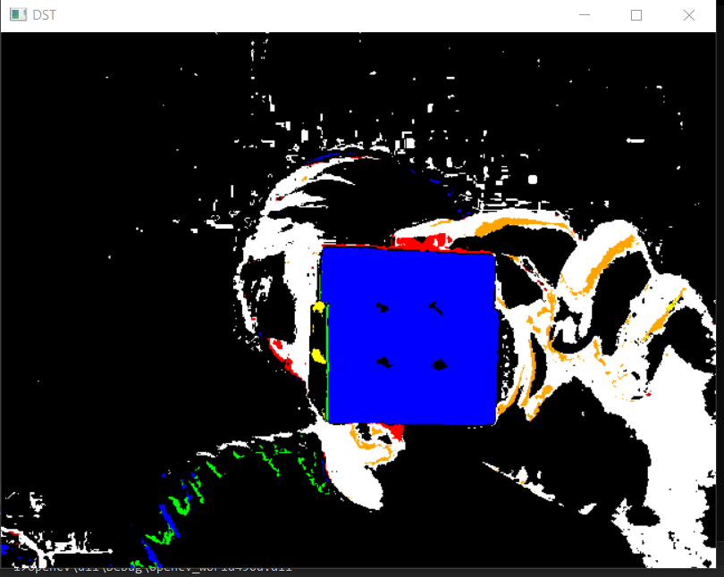
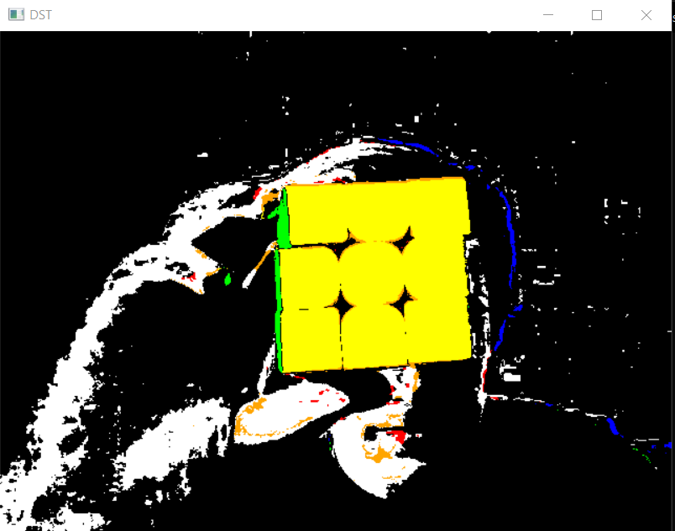
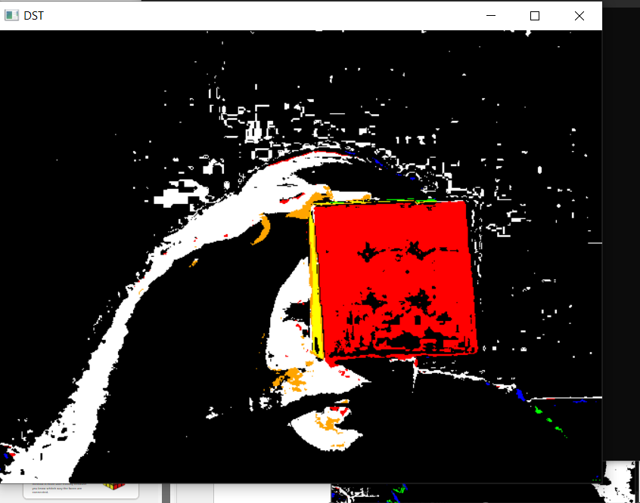
Color Tresholding
I transform the original frame into just basic colors such that we can see if the color is detected correctly. Moreover, this frame is used for the final mapping, by using the same solid colors and we can traverse the image in between the borders and check which color is most prevalent, to avoid small errors and anomalies.

Slide 8
Demonstration
I prepared a short video demonstration
Link to the demo video: https://youtu.be/_k2B2vfo_vw

Slide 9
Results
My algorithm gives accurate representation of the colors in a warm light environment. This is simulated with a lamp with a yellow bulb.
In normal White light environment the detection of the White and Orange is slightly altareted due to slight hue variations in the ranges of the colors.

Slide 10
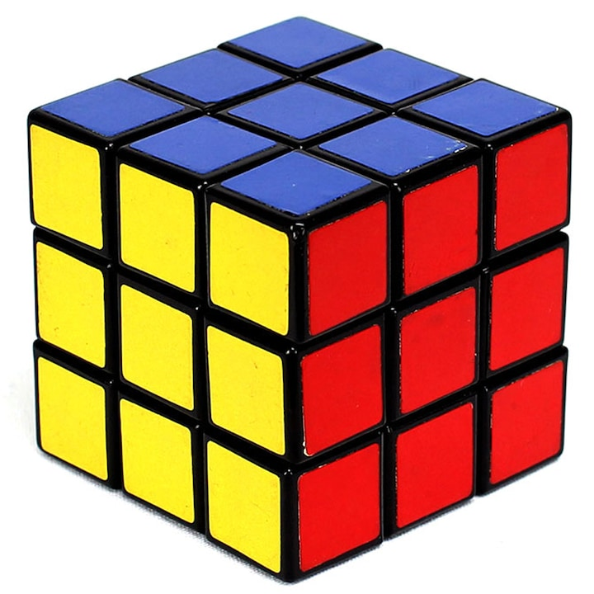
Other ways to solve the problem
By taking the picture at an angle, you can reduce the number of photos taken to 2 instead of 6. This speeds up the process, but it is not as accurate due to the fact that there is less area to analyse per square of the face.
In my method, the user can have an errored version of the spread cube because my algorithm does not track the orientation of the faces. The other method is more user friendly because you know whitch way the faces are connected.

Slide 11
Bibliography
https://stacks.stanford.edu/file/druid:yj296hj2790/Ng_Rubiks%20Cube_Reconstruction_from_Images.pdf
https://docs.opencv.org/4.x/de/d25/imgproc_color_conversions.html#color_convert_rgb_hsv
https://docs.opencv.org/4.x/
https://en.wikipedia.org/wiki/Rubik%27s_Cube

Slide 12
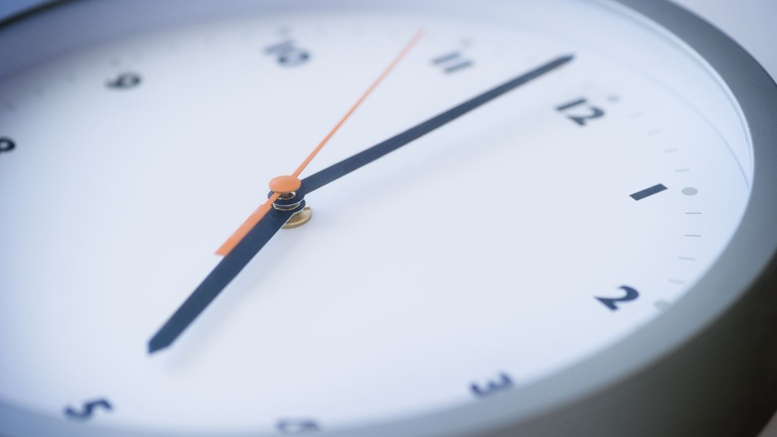
Thank you for your time!

